Slide 1
Security Reasoning via Substructural Dependency Tracking
Hemant Gouni, Frank Pfenning, Jonathan Aldrich

Slide 2







Dependency Tracking
A
B
free()
free()
free()

Slide 3



Dependency Tracking
Nuclear launch code
TOP SECRET
PUBLIC
Military Contract
TOP SECRET
SECRET
Gov employee salary
PUBLIC

Slide 4

Dependency Tracking
Nuclear launch code
TOP SECRET
PUBLIC
Military Contract
TOP SECRET
SECRET
Gov employee salary
PUBLIC
Can tweet about anything Homer knows
Cannot tweet anything contain secret/top secret information
PUBLIC

Slide 5
Dependency Tracking
Resource limitations
Happened-before order
Multi-level capacity
Guarantee?
If I specify a usage,
the program must satisfy the expectation
Substructural Type System

Slide 6
Substructural Type System
From substructural logic:
Weakening
Contraction
Exchange
Resource can be ignored
Γ ⊢ B
-------------
Γ, A ⊢ B
Resource can be duplicated
Γ, A, A ⊢ B
-------------
Γ, A ⊢ B
Resource can be reordered
Γ, A, B ⊢ C
-------------
Γ, B, A ⊢ C
Affine: no contraction
Linear: no contraction, no weakening
Ordered: no contraction, no weakening, no exchange

Slide 7
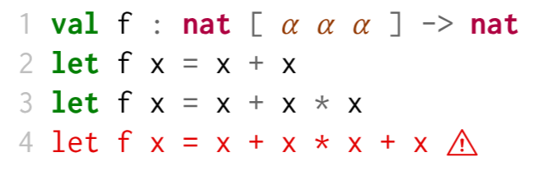
Substructural Type System
Affine: resource cannot be duplicated
Program in Affine Type:
Type interpret how we use input resources

Slide 8
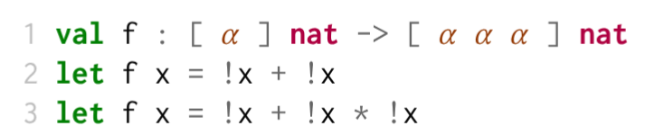
Output-Based Reasoning
Track how we run the input computation to get the resource
Run the input will
release an α resource and
receive a nat
How many times you can run the input

Slide 9
Modes & Resource Contexts
Substructural Modes 𝑚 ⊆ { weaken, contract, exchange}
Resource Variables 𝜌
Resource Contexts 𝜙 :
a sequence of resource variables 𝜌^{𝑚} annotated with supported substructural mode
e : [ A · 𝜙₁ ] | 𝜙₂
-------------------
!e : A | 𝜙₁ 𝜙₂
Run computation produce resource

Slide 10
Output-Based Reasoning
e : [ 𝜙₁ ] A | 𝜙₂
-------------------
!e : A | 𝜙₁ 𝜙₂
Consider the following program in Affine Mode
x: [ α ] nat |
-------------------
!x : nat | α
-------------------
!x + !x : nat | α α
[α α] compatible with [α α α]?

Slide 11
Compatible Resource Contexts
Weakening
Γ ⊢ B
-------------
Γ, A ⊢ B
𝜙₁ ⊑ 𝜙₂
when 𝜙₁ can be rewritten to 𝜙₂
In Affine Mode, resource can be ignored by weakening
[α α]
----------
[α α α]

Slide 12
Output-Based Reasoning
Contraction:
Resource can be duplicated
Γ, A, A ⊢ B
-------------
Γ, A ⊢ B
!x + !x * !x + !x : nat | α α α α
In Affine Mode, resource can't be duplicated by contraction
[α α α α] ↛ [α α α]

Slide 13

Output-Based Reasoning
But why output-based not input-based?

Slide 14
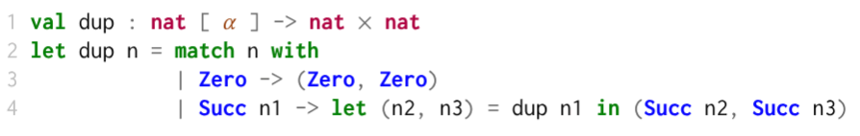
Output-Based Reasoning
Affine: resource cannot be duplicated
Consider the following program in affine type:
Doesn't work well with values that can be pattern matched

Slide 15
Output-Based Reasoning
Most of the time, we don't just want to work on one substructural mode
We want to be able to switch between them in the framework

Slide 16


Example 1: Capability (no weakening)
PUBLIC
auth()
Nuclear launch code
TOP SECRET
secure( )
TOP SECRET

Slide 17
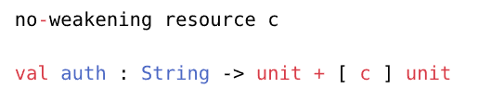
Example 1: Capability (no weakening)
If authentication is successful, auth() function will generate and return a capability token.
If authentication fails, auth() will return nothing.

Slide 18
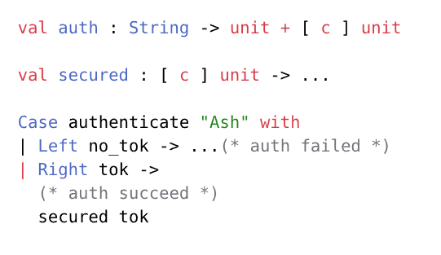
Example 1: Capability (no weakening)
After successful authentication, we can pass the generated capability token to the secured() function.

Slide 19
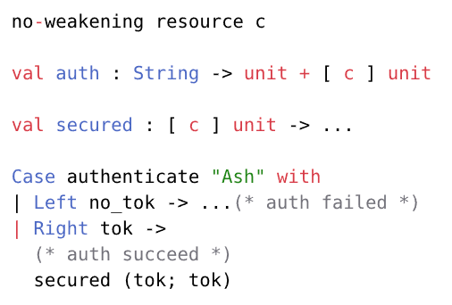
Example 1: Capability (no weakening)
What if I got authenticated multiple times?
tok; tok : [c c] unit
[ c c ] ⊑ [ c ] ?

Slide 20
Example 1: Capability (no weakening)
Contraction:
Duplicate resource
Γ, A, A ⊢ B
-------------
Γ, A ⊢ B
As long as I am authenticated, it shouldn't affect the result.
[ c c ] ⊑ [ c ]
🙆‍♀️
Contraction

Slide 21
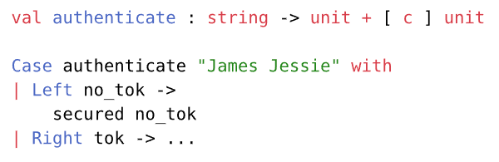
Example 1: Capability (no weakening)
Weakening
Ignore resource
Γ ⊢ B
-------------
Γ, A ⊢ B
no weakening
When authentication fails, I shouldn't be allowed to call secured().
no_tok: [ ] unit
[ ] ⊑ [ c ] ?
🙅‍♀️
[ ] ⊑ [ c ]

Slide 22
Example 2: Linear Capability (no weakening, no contraction)
A
B
incr()
decr()
The number of processes allowed to write at a time should be limited.
int*

Slide 23
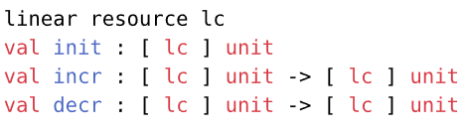

Example 2: Linear Capability (no weakening, no contraction)
incr() and decr() take one [ lc ] token, perform write, and return the token.
To specify "only one process should be allowed to write at a time"...

Slide 24

Example 2: Linear Capability (no weakening, no contraction)
one [ lc ] instance in a program is fine

Slide 25
Example 2: Linear Capability (no weakening, no contraction)
Contraction:
Duplicate resource
Γ, A, A ⊢ B
-------------
Γ, A ⊢ B
no contraction
If we allow two processes run in "parallel" in our program...
🙅‍♀️
[ lc lc ] ⊑ [ lc ]

Slide 26
Example 2: Linear Capability (no weakening, no contraction)
To allow two concurrent execution...

Slide 27
Example 3: Privilege-Dropping Protocols seccomp
Syscall
Kernel
Process
seccomp()
Allowed
Syscall
Container
Seccomp filter
Blocked
Error
seccomp() drop privileges for the process from high to low

Slide 28
Modes
Substructural Modes 𝑚 ⊆ { weaken, contract, exchange}
More expressive...
Substructural Modes 𝑚 ⊆
{ weaken,
contract forward, contract backward,
exchange forward, exchange backward}

Slide 29
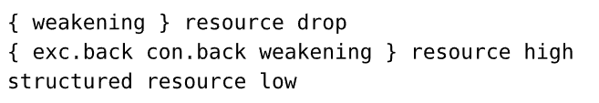
Example 3: Privilege-Dropping Protocols seccomp
Before privilege dropping, process should be able to perform any low or high operations.
After privilege dropping, process should only be able to perform low privilege operations.
High privilege
Low privilege
seccomp()

Slide 30
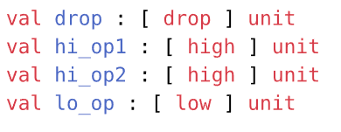

Example 3: Privilege-Dropping Protocols seccomp
Specification:

Slide 31
Example 3: Privilege-Dropping Protocols seccomp
Contraction:
Duplicate resource
Γ, A, A ⊢ B
-------------
Γ, A ⊢ B
[ high drop low low ] ⊑_{drop, low,high} [ high drop low ]
No limitation for low privilege syscall

Slide 32
Example 3: Privilege-Dropping Protocols seccomp
Weakening
Ignore resource
Γ ⊢ B
-------------
Γ, A ⊢ B
[ low high ] ⊑_{drop, low,high} [ high drop low ]
drop can be weakened

Slide 33
Example 3: Privilege-Dropping Protocols seccomp
Contraction:
Duplicate resource
Γ, A, A ⊢ B
-------------
Γ, A ⊢ B
🙅‍♀️
[ high drop low high ] ⊑_{drop, low, high} [ high drop low ]
We specified that high appeared before drop
Backward exchange and contraction only allow high to move to the right

Slide 34
Example 3: Privilege-Dropping Protocols seccomp
Compatible usages:
[high high drop low]
[high low drop low]
[high drop]
[high low drop]
Incompatible usages:
[drop high]
[low drop high]
...

Slide 35
Soundness
If a well-typed term is under the expected resources,
After evaluation,
the computation produces resources that are compatible with the expected resources.

Slide 36
Safety
Compatibility safety, protocol safety, etc
Compatibility safety as example:
If e : [c a1... ] where c is no-weakening, then when the evaluation finish, it produce [b1, b2...] with c inside of [b1, b2...]
Soundness + lose weakening
The soundness theorem was used to instantiate all safety guarantees

